Slide 1
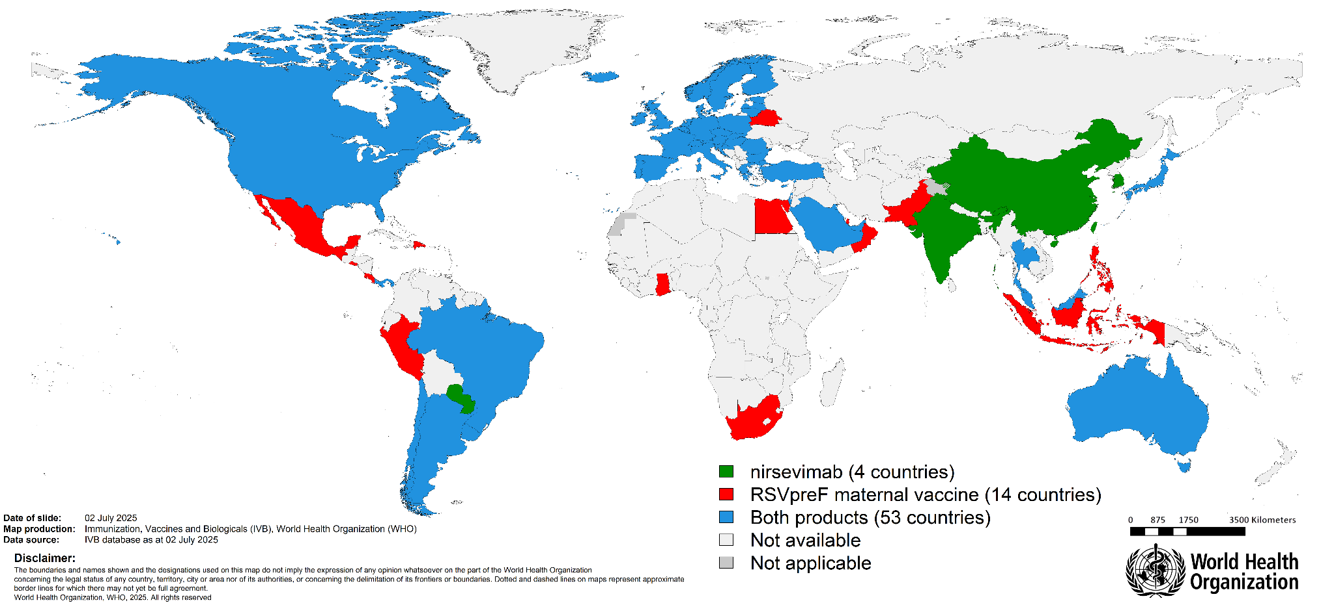
Global market authorizations of RSV immunization products to protect infants
‹#›

Slide 2
Global market authorizations of RSV immunization products to protect infants
As of June 2025, 71 countries/regions have regulatory approval for the maternal vaccination and mAb
Total countries per product | Maternal Vaccination | mAb
 | 67 countries | 57 countries
Only 1 product | 14 countries | 4 countries
Both products | 53 countries
BOTH PRODUCTS
53 countries/regions
Argentina | China, Hong Kong SAR | Poland
Australia | Hungary | Portugal
Austria | Iceland | Romania
Bahrain | Ireland | Saudi Arabia
Belgium | Israel | Singapore
Brazil | Italy | Slovakia
Bulgaria | Japan | Slovenia
Canada | Kuwait | Spain
Chile | Latvia | Sweden
Croatia | Lichtenstein | Switzerland
Cyprus | Lithuania | Chinese Tapei
Czech Republic | Luxembourg | Thailand
Denmark | Macau SAR | Turkey
Estonia | Malaysia | United Arab Emirates
Finland | Malta | United Kingdom
France | Netherlands | The United States
Germany | Norway | Uruguay
Greece | Panama
ONLY MATERNAL VACCINATION
14 countries
Belarus
Costa Rica
Dominican Republic
Egypt
El Salvador
Ghana
Indonesia
Mexico
Oman
Pakistan
Peru
Philippines
Qatar
South Africa
ONLY mAb
4 countries
China
India
Paraguay
Republic of Korea
‹#›

Slide 3
Global introductions of RSV immunization products to protect infants
As of June 2025, 24 countries have introduced the maternal vaccination and/or the mAb
Total countries per product | Maternal Vaccination | mAb
 | 6 countries | 12 countries
Approach | 2 season approach 4 year-round approach | 10 (all infants) 2 (high risk only)
ONLY mAb
Country | Approach
Austria | All infants
Brazil | High risk
Canada | All infants
Chile | All infants
Finland | All infants
Germany | All infants
Ireland | All infants
Italy | All infants
Japan | High risk
Paraguay | All infants
Portugal | All infants
Spain | All infants
BOTH PRODUCTS
Country | Primary Product | Approach
Australia | Maternal Vaccination | Year-round
Belgium | mAb | All infants
France | mAb | All infants
Luxembourg | mAb | All infants
Switzerland | mAb | All infants
United States | mAb | All infants
Product | Approach
Maternal Vaccination | Seasonal
Maternal Vaccination | Year-round
mAb | All infants*
mAb | High risk
ONLY MATERNAL VACCINATION
Country | Approach
Argentina | Seasonal
Costa Rica | Year-round
Poland | Year-round
Slovenia | Year-round
United Kingdom | Year-round
Uruguay | Seasonal
‹#›
*Disclaimer: "All infants" category used in this presentation encompasses varying age ranges depending on country-level introduction (e.g., <6 months, <8 months). For the purpose of simplification and consistency, all have been collectively categorized as "all infants."

